Slide 1
Strategies for Advancing Hidden Collections: A CLIR Webinar Series
Joy M. Banks, MSLS
SFA Annual Meeting
St. Petersburg, FL
May 11, 2017
Notes:
Good Morning! My name is Joy Banks, and I had the pleasure of serving for the last year as the Project Coordinator for the Council on Library and Information Resources, or CLIR, developing a new webinar series.

Slide 2
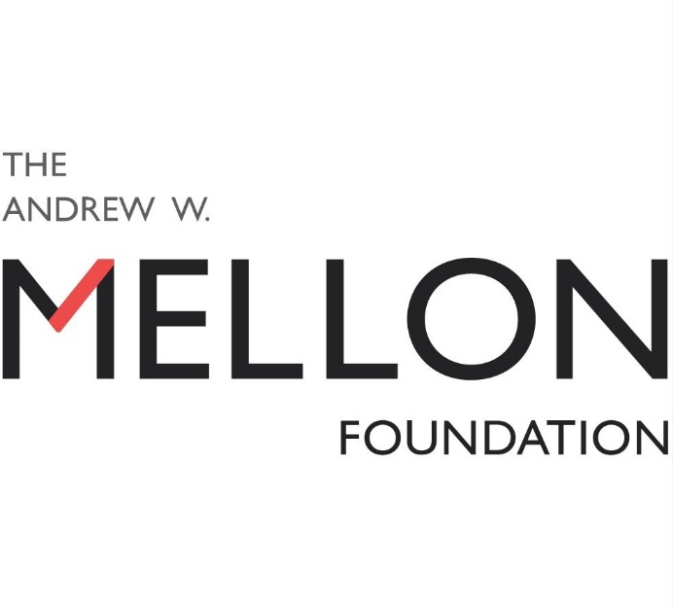
The Background
Notes:
Just as some background to the project…
Between 2008 and 2014, CLIR, with the generous support of the Andrew W. Mellon Foundation awarded over $27.5 million through its Cataloging Hidden Collections grant program. To disseminate the lessons learned from the wide variety of funded projects, CLIR undertook the development of six, free 90-minute webinars and an online resource library.

Slide 3
The Team
Project Coordinator
Staff
Amy Lucko, Director of Program Administration, CLIR
Christa Williford, Director of Research and Assessment, CLIR
Nicole K. Ferraiolo, Program Officer for Scholarly Resources, CLIR
Adam Leader-Smith, Program Associate, CLIR
Joy M. Banks, Consultant
eLearning Consultant
Louise Gruenberg, Sr. Usability Officer, ALA
Notes:
Our team combined the expertise of CLIR staff, two consultants…

Slide 4
The Team
Curriculum Committee
Stephanie Gaub Antequino, Memorabilia Archivist, Planet Hollywood International
Casey Davis, Project Manger, American Archive of Public Broadcasting
Tamar Evangelista-Dougherty, Consultant
Linda Hocking, Curator of Library and Archives, Litchfield Historical Society
Daniel Johnson, Digital Preservation Librarian, University of Iowa
Holly Mengel, Manuscripts Cataloging Librarian, University of Pennsylvania
Matthew Peek, Military Collections Archivist, State Archives of North Carolina
Kelly Revak, Processing Archivist, Library of Congress
Notes:
And our diverse curriculum committee. Based on analysis of the responses we received from a survey widely distributed at the beginning of the webinar project and keeping in mind our goal to serve institutions with limited budgets and staffing, we developed a practical series of topics aimed at helping individuals in GLAM (that is, Gallery, Library, Archive, and Museum) organizations to confidently approach those collections that may be hiding in those dark closets we all have.

Slide 5
Strategies for Advancing Hidden Collections
CLIR Presents…
Notes:
The product of that development is the Strategies for Advancing Hidden Collections series.

Slide 6
SAHC
Where to begin: Basics of project planning for GLAM organizations – Angela Kipp, Collection Manager, TECHNOSEUM
Building resources and relationships: Determining what and who you need – Rosemary Pleva Flynn, Principal Librarian, EERC at the University of North Dakota
Making the most of people: Recruitment, retention, and recognition – Sarah Leu, Project Archivist, Historical Society of PA
Collection access: Describing, cataloging, and processing with the future in mind – Beth Knazook, Library Juice Academy
Overcoming project hurdles: Approaches to identifying and managing collection red flags – Jessica Bitely, Dir. of Preservation Services, NEDCC and Yvonne Ng, Senior Archivist, WITNESS
Closing the loop: Project assessment and leveraging goals for future planning – Ellen Ryan, Head of Special Coll. and Archives, Idaho State University
Notes:
While the live webinars are now complete, recordings, transcripts, and supplemental materials for all six sessions are now freely available online. Our talented group of speakers hailed from a variety of institutional backgrounds, creating a rich learning experience for participants.
**Insert links to webinars***

Slide 7
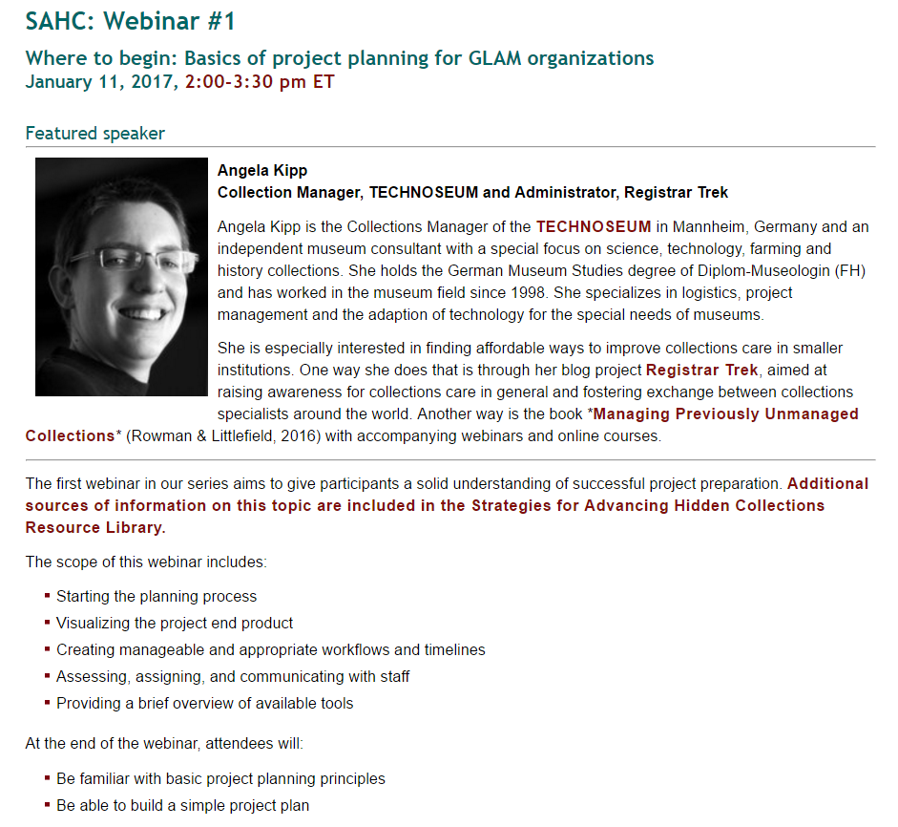
Each webinar page includes:
Speaker bio
Webinar overview
Links to
Recordings
PowerPoint presentations
Transcripts including all chats
Online resource library
Evaluation for access to a Certificate of Completion
Notes:
In Hosted on the CLIR SAHC website, each webinar has a separate page that includes access to useful information and resources.

Slide 8
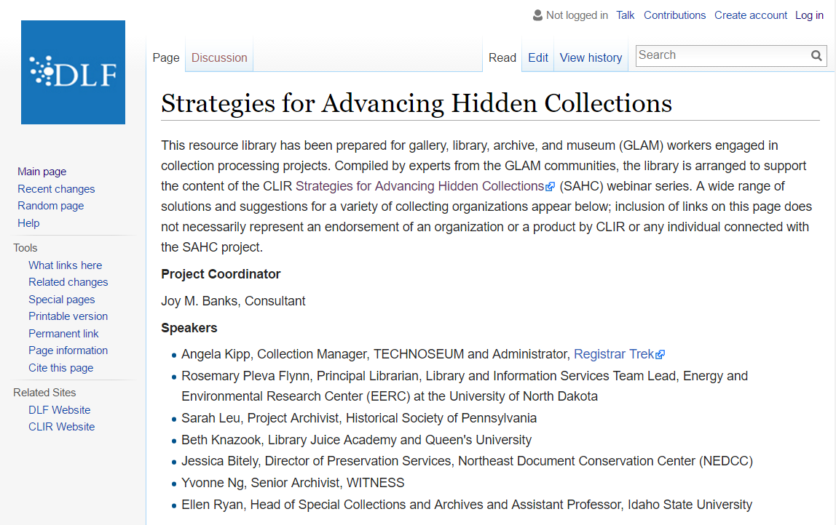
Online Resource Library
Notes:
In addition to the webinar recordings, the SAHC team also developed an extensive online resource library to compliment the content of the educational sessions. The wiki is organized by the topics of the individual webinars and includes cross linking for related content. The library is in wiki format and can be supplemented by any registered user.

Slide 9
In Summary…
Strategies for Advancing Hidden Collections (SAHC)
https://www.clir.org/hiddencollections/sahc
Notes:
CLIR is committed to supporting access to this series for several years to come and hopes that it will provide many individuals valuable support and encouragement to tackle difficult collections. There are plans to provide additional ways to access the webinars, including uploading versions to YouTube which will have closed captioning. CLIR is also looking forward to creating additional educational content in the future.

