Slide 1
Helping Each Other:
An Overview of the Florida Connecting to Collections’ Developing Emergency Plans Program
Robin Bauer Kilgo
Special Projects Manager, FAM
Susan Swiatosz, Librarian
Boynton Beach City Library

Slide 2









Partnership

Slide 3
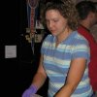

FAM C2C Project Team
Robin Bauer Kilgo
Special Projects Manager, FAM
robin@flamuseums.org
Malinda Horton
Executive Director, FAM
FAM@flamuseums.org
Laura Nemmers
Project Associate, FL C2C
lauranemmers@gmail.com

Slide 4


FL C2C 2015 – Developing ER Plans
Emergency Plans
  8 Modules
  Webinars
  Activities
    Discussion Questions
    Practical Activities
  Samples
  Online Resources
http://flamuseums.org/professional-development/florida-connecting-to-collections-program/emergency-plans/

Slide 5
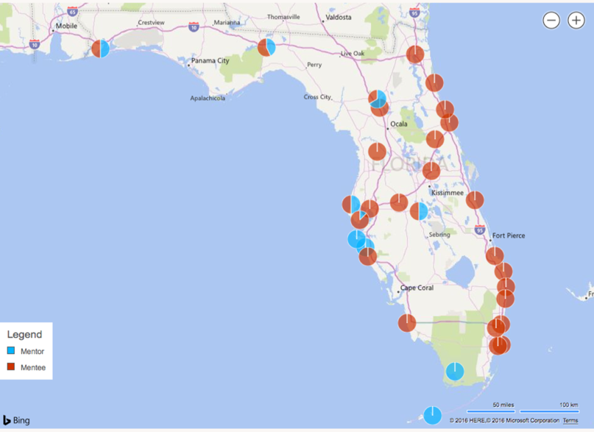
FL C2C 2015 – Developing ER Plans
77 Participants
13 Mentors
64 Mentees
51 Organizations
12 Archive/Special Collections
3 Archaeological

Slide 6
Same Process in 3/4 Regions
Each module = 2 workshops
Workshop 1 held at mentor organizations
  Content based with an emphasis on webinars and in-person discussion groups
Workshop 2 held at mentee organizations
  Participate in Collections Care Enhancement – Involving Boards (CCE-IB)
  Practical Activity based upon subjects covered in Workshop 1

Slide 7
On-line Community
http://florida-association-of-museums.network-maker.com/

Slide 8
FAM/FLC2C-Webinar on You Tube
Search for “Florida Association of Museums”

Slide 9
2017 – CMP/CDP-Schedule
**Now Enrolling!!
Module 1: Policies vs. Plans vs. Procedures/Scope of Collections/Acquisitions & Accessions – Deaccessions & Disposals
Workshop #1: December 9, 2016
Webinar/In-Person Discussions
Mid-Module Webinar: Abandoned Property/FIC
Workshop #2: January 20, 2017
Collections Assessment/Practical Exercise
Module 2: Loans/Documentation/Inventory and Audits
Workshop #1: February 24, 2017
Webinar/In-Person Discussions
Mid-Module-Webinar: Insurance/Risk Management
Workshop #2: April 7, 2017
Collections Assessment/Practical Exercise
Module 3: Access and Use/Collections Care/Intellectual Property
Workshop #1: May 22, 2017
Webinar/In-Person Discussions
*Mid-Module Potential Webinars: Digitization or Integrated Pest Management
Workshop #2: June 23, 2017
Collections Assessment/Practical Exercise
Module 4: Putting your Document Together & Special Topics
Workshop #1: August 4, 2017
Webinar/In-Person Discussions
*Mid-Module Potential Webinars: Sustainability or Code of Ethics
Workshop #2: September 1, 2017
Online Writers Workshop

Slide 10
Elements of an Emergency Plan

Slide 11
Parts of Plan
Introduction/ Instructions
Delegation of Authority
Emergency Teams
Emergency Contact List/Phone Tree
Summary of Hazards/Threats
Evacuation Guidelines
Action Plans for Identified Threats
Priority List
Communication/
Documentation
Collection Salvage/Recovery
Supplies
Additional Supplies/Resources
Training
Review Schedule

Slide 12

1. Introduction/Instructions
Policy Statement
  Sets the stage. Describes to all readers and users of plan just what will be covered in the plan and what was involved in the creation.

Slide 13

2. Delegation of Authority
Director must :
  Designate responsibility and provide support
  Select most qualified personnel to organize staff in a coordinated effort
  Involve all staff in preparedness and response planning process
  Share information
Team approach-enhances planning effort and staff morale
Identify risks and priorities

Slide 14
3. Emergency Teams
Team Responsible for Preparedness:
  Establish and review priorities for protection and recovery
  Review Emergency and Response Plan annually
  Review building logs semiannually to look for patterns where preventative measures should be taken and to determine whether any unresolved issues should be addressed.
  Present and attend disaster training and response workshops.

Slide 15

4. Emergency Contact List/Phone Tree
Example
  EMERGENCY CONTACT LIST
  In addition to members of the Disaster Coordination Team, the following persons should be contacted in the event of an emergency to alert members of their Department:
  NAME OFFICE HOME CELL
  Head Librarian 555-5555 876-1234
  Assistant Librarian 555-5557 876-1243
  Reference Desk 555-5558 876-1222
  Department of Scientific Computing 123-4567 876-1233

Slide 16
5. Summary of Hazards/Threats
Formalized list of the types of hazards that can occur at your particular facility.

Slide 17
5. Summary of Hazards/Threats
Lists commonly include the following:
  Fire
  Flooding or Water Damage
  Medical Emergency
  Power failure
  Pest and mold outbreak
  Bomb threat
  Severe storm
  Hurricane
  Active shooter/workplace violence

Slide 18
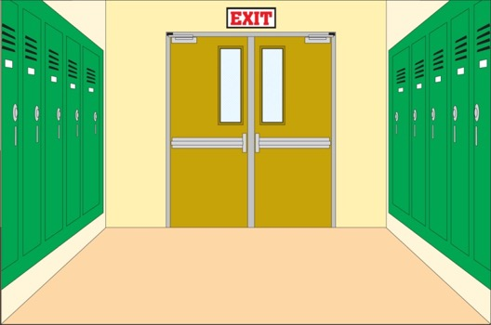
6. Evacuation Guidelines
Actions that will take place whenever institution will need to be evacuated during a time of threat or hazard.
Should be created in consultation with emergency responders.

Slide 19
7. Action Plans for Identified Threats
Plans and activities that will take place when threats and hazards have been identified by governing authority.
Should be based upon threats and hazards that were listed earlier in plan.

Slide 20
7. Action Plans for Identified Threats
Example:
  Flooding or Water Damage
    Notify Supervisor in charge with the location and severity of the leak.
    Do not walk in standing water – it may be electrified or contaminated.
    If there is any possible danger, evacuate the area.
    Take only those steps needed to avoid or reduce immediate water damage.
    Cover shelf ranges with plastic sheeting; carefully move materials out of the imminent danger.

Slide 21

8. Priority List
Priority One-High priority materials:
  Irreplaceable, unique and rare collection material,
  Strong collections,
  Heavily-used collections.
Priority Two-Core collection materials
Priority Three-Lesser priority materials, characterized as follows:
  Materials owned or accessed in another format
  Subject areas where currency is most important
  Subject areas that not heavily used/marginal value and interest.

Slide 22
9. Communication/Documentation
Communication with the Response Team is the most important job you have.
  Need system for communicating with the outside world: emergency responders, administrators, contractors and the press.
  Keep staff informed about the disaster as response and salvage progresses.
  Coordinate all communication going to media liaison.

Slide 23

9. Communication/Documentation
Documentation also essential role in emergency planning.
  Keep accurate records for proof of loss for state/federal assistance, insurance claims.
  May also be used for future fund-raising and to assist with media coverage.
  Helps establish salvage priorities
  Assists with post-disaster analysis.
  Keep track of staffing needs and staff time used.

Slide 24
10. Collection Salvage/Recovery
Salvage involves retrieving your organization’s damaged collections from areas affected by the emergency as well as protecting collections at risk of damage.
Salvage should be carried out systematically based on well thought-out collections priorities.

Slide 25
10. Collection Salvage/Recovery
Specific steps involved in salvage:
  Set Salvage Priorities
  Determine Needed Resources
  Instruct Staff
  Triage – sort items based on salvage priorities
  Relocate Material for Salvage
  Be systematic, flexible, and stay organized
  Pack and Label Boxes
  Keep proper documentation

Slide 26
11. Supplies
Check what supplies and equipment you actually have on hand. Home improvement, office supply and discount department stores have the supplies needed immediately.
Assemble them near the disaster site.
Assess need for additional supplies and services with Response Team Leader and Salvage Coordinator.

Slide 27
11. Supplies
Arrange a secure storage location for supplies.
Establish and maintain clear lines of communication with contractors.
Continue to monitor the need for supplies throughout the response and salvage phases.

Slide 28
12. Additional Supplies/Resources
Also good to have a list of outside suppliers on hand when you get in an emergency.

Slide 29
13. Training
Provide guidance and support
Make sure employees and volunteers have knowledge and skills to respond effectively, efficiently, and appropriately in an emergency situation.
Regularly conduct drills, debriefings, and training sessions

Slide 30
13. Training
Training helps cultivate teamwork
Involve ALL staff in emergency training
Most staff members need to practice evacuation procedures, basic object handling, and salvage techniques.

Slide 31

14. Review Schedule
Annual review of the Emergency and Response Plan
Review priorities for protection and recovery

Slide 32

Q & A

