Slide 1
Putting the Volunteer in the Driver’s Seat
Revs Digital Library
Jessica Bright, Digital Library Coordinator (jbright@revsinstitute.org)
David Santiago, Digital Project Assistant (dsantiago@revsinstitute.org)
Notes:
2011-023LEGR-b2_29.0_0004

Slide 2
Find Your Audience
Subject matter is key.
Whatever your subject matter, there is a group out there who is also passionate about it .
When we mention cars, just insert your subject.

Slide 3
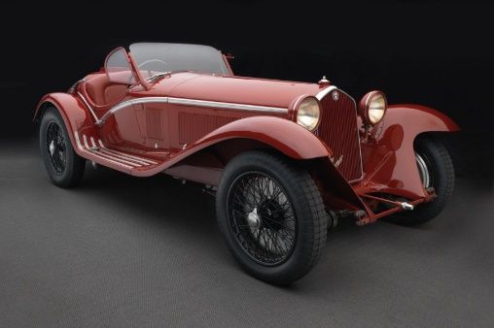
The Revs Institute
501(c)(3) open to public
Living art museum with cars
Auto as cultural icon and change agent
21 FTE staff
150 volunteers
Collier Collection

Slide 4
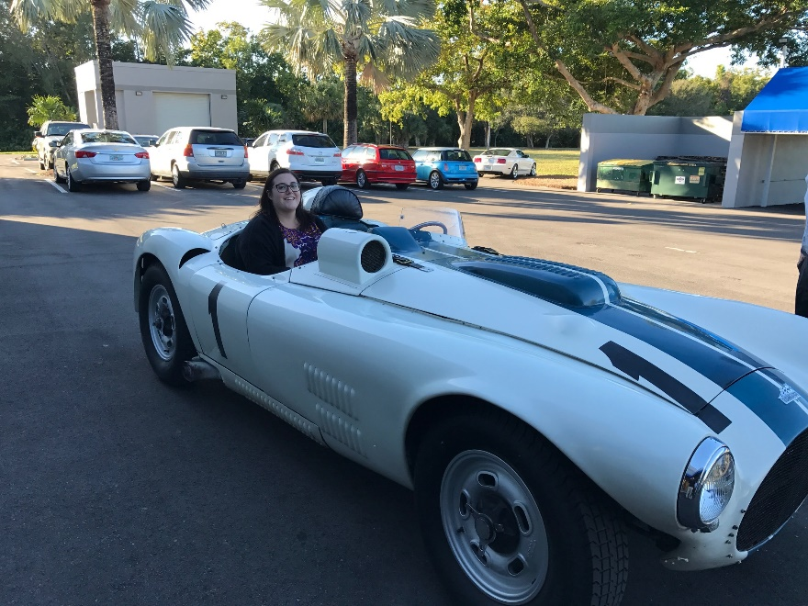
Library & Archives
Focus
Pre-eminent library on automotive history
US and European marques, Alfa-Romeo, Bentley, Cunningham, Ferrari, Mercedes, Porsche
Staff
7 FTE staff: 2.5 digitizing
Interns, volunteers
Collections
Largest collection of US, European auto books, journals, manuals, photographs
Notes:
1952 Cunningham C-4R

Slide 5
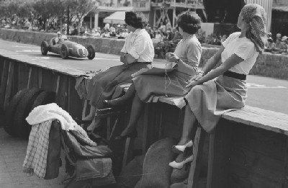
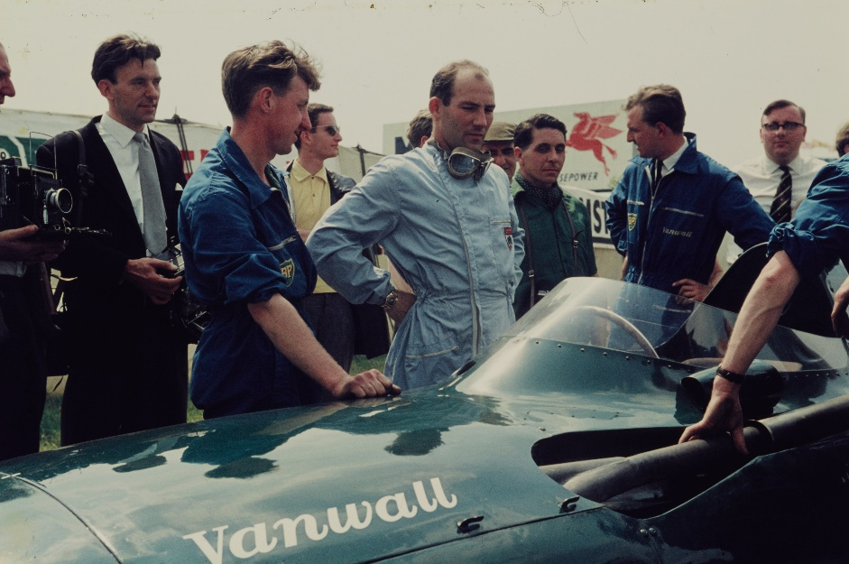
Photo Collections
1 million slides & negatives
1 million prints
50,000 born digital images
Notes:
PURL: https://purl.stanford.edu/gq435jt0996 ; Identifier: 2011-023MAIL-b1_23.0_0011 ; 1950 Monaco Grand Prix
https://purl.stanford.edu/sy012hb2279 ; 2011-039MART-b1_23.2_0011 ; 1958 British Grand Prix

Slide 6
Putting It Together
The Revs Institute Facebook site

Slide 7
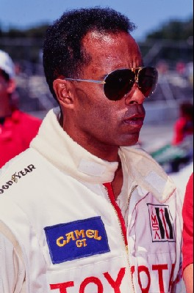
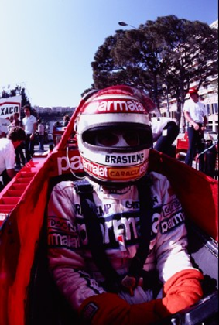
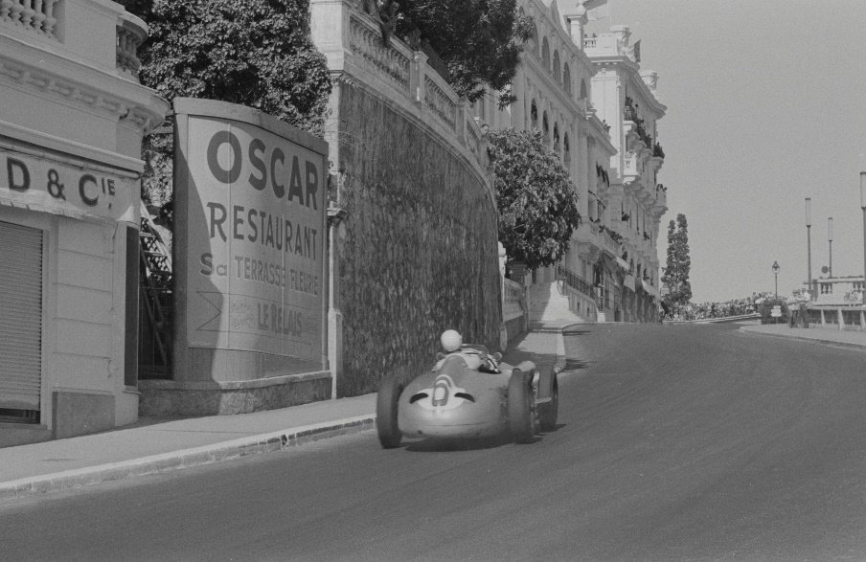
Revs Digital Library Goals, 2012
Slides & negatives as priority
Demand for racing legacy
Meet archival standards
Not for revenue
Notes:
https://purl.stanford.edu/jy344yn2171 ; Identifier: 2012-015GHEW-TR-1991-b38_2.0_0005
https://purl.stanford.edu/pv844bh8754 ; Identifier: 2011-023NIEL-1970-b6_2.1_0011
https://purl.stanford.edu/cp616sp8467 ; 2006-001PHIL-1955-b1_33.2_0028 ; Monaco Grand Prix 1955

Slide 8
Revs Digital Library Workflow
Hosted by Stanford University
Digitization is outsourced to Pixel Acuity
The Revs Institute Library staff and volunteers:
Process images
Create metadata

Slide 9
Revs Digital Library
Notes:
Revs Digital Library Home Page

Slide 10
Item Level Metadata
Notes:
Identifier: 2012-015GHEW-TR-1990-b27_1.0_0003 ; PURL: https://purl.stanford.edu/gc194hz2979

Slide 11
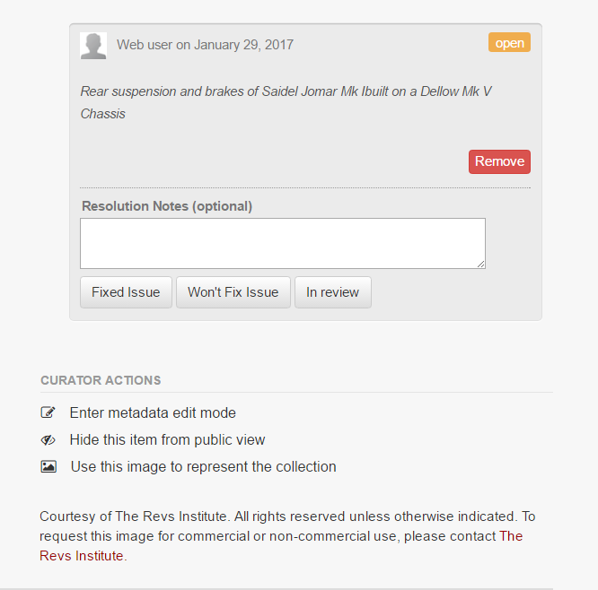
Flags
Notes:
2015-012BURN-b3_2.19_0004

Slide 12
Saved Searches

Slide 13
Volunteers and Users
Volunteers:
Officially affiliated with Revs
Receive training from Revs
Users:
Not affiliated with Revs
Find us through various methods
Only work remotely through Digital Library by creating flags
Work on all aspects of Digital Library: processing, metadata, flags

Slide 14
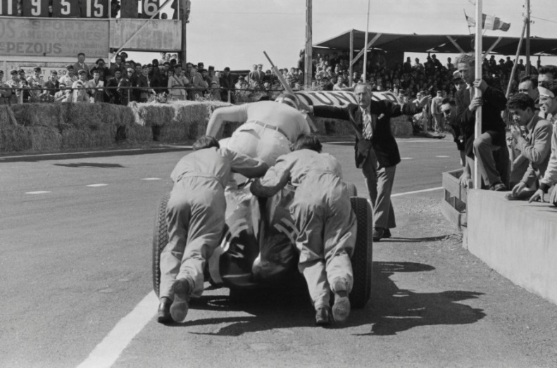
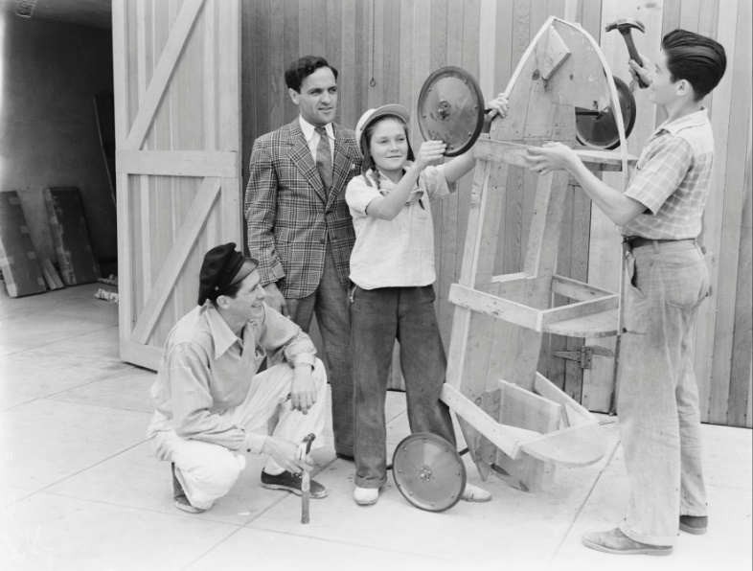
Crowdsourcing
110 current registered users
90,000 total flags
Notes:
TOP:
Identifier: 2006-001PHIL-1953-b1_28.2_0005 ; PURL: https://purl.stanford.edu/hz379wk9798
BOTTOM:
Identifier: 2004-100CRAI-b7_8.0_0004 ; PURL: https://purl.stanford.edu/cx530ck9800

Slide 15
Other Users on the Digital Library
Not all associated with Revs
Anyone can create an account on the Digital Library
They find us through many different channels:
Auto industry people
Racing fans
Family members of drivers featured in our collections
Historians, researchers, and authors

Slide 16
Volunteer/User Time Effort
Core group of 8-10 volunteers and users
Contribute 80 hours/week collectively
Assist with all aspects of Digital Library

Slide 17
Volunteer Projects
Process image collections
Create and input metadata in Excel spreadsheets
Add and edit metadata directly on the Digital Library
Create flags on the Digital Library
Resolve flags on the Digital Library

Slide 18
Expert Knowledge
Many involved in auto industry / racing for years
Come from all different backgrounds
Incredibly knowledgeable and eager to share
Many have niche interests: marques, race teams, series, etc.

Slide 19
Putting the Crowd in Crowdsourcing
Word-of-mouth
No recruiting done
Active social media base for Revs
Know of the Revs car collection and are drawn to the library as well

Slide 20
Benefits of Crowdsourcing
Generates multitude of metadata
Does not require additional staffing
Builds community
Provides obscure information we cannot
Time saver
Ongoing process

Slide 21
Takeaways
Active Audience
Network Building
Specific Subject
Accessible Worldwide
Notes:
Identifier: 2014-029DELL-BW-1967-b4_39.8_0020 ; PURL: https://purl.stanford.edu/pb478gr3215

